Slide 1



Data For You
Poverty Measures:
What They Are and How To Use Them
Sandra Burke with Cynthia Fletcher, Liesl Eathington,
Mary Beth Foster, Glennda Bivens, and Bailey Hanson
American Community Survey
Iowa State University Extension and Outreach
Staff Professional Development June 4, 2015

Slide 2
Figure 1. Poverty
lack of or scarcity of a certain amount of material possessions or money
commonly includes access to: food, water, sanitation, clothing, shelter, health care, education
other dimensions: life expectancy, physical security, lack of opportunity to better one’s life
access to goods and services commonly taken for granted

Slide 3
Figure 2. Poverty Measures and Information Sources
measure poverty by lack of income
American Community Survey (Census Bureau)
Poverty Thresholds (Census Bureau)
Poverty Guidelines (Health and Human Services)
Income Limits (Housing and Urban Development)

Slide 4
Figure 3.
Small Area Income and Poverty Estimates (SAIPE) (Census Bureau)
Current Population Survey’s Annual Social and Economic Supplement (Census Bureau)
Free and Reduced School Meals program
(U.S. Department of Agriculture)
Supplemental Nutrition Assistance Program (SNAP/food stamps) (USDA)

Slide 5
Figure 4. Measures and Information for 2 things:
1. Estimates and statistics of how many people, families, children, etc. in a particular geographic region are determined to be in poverty and likely have unmet basic needs because their income is too low
2. Guidelines for eligibility for various assistance programs

Slide 6
Figure 5. How Poverty is Determined
Poverty for families and individuals results when there is not enough income to meet basic needs
Income is of primary importance when determining poverty status in the ACS, other estimates programs, as well as determining eligibility for assistance programs
Income is compared to standardized $$ amounts, poverty thresholds or guidelines, to see if it is below what is considered an amount that is essential for basic needs or if the family or person can qualify for assistance programs

Slide 7
Figure 6. However….as always….complications
Consider how the ACS, other estimate programs, and agencies count income; what is included as income? This can vary from program to program and agency to agency. Are assets included in determining eligibility?
Consider who is included in the poverty universe….not everyone is included
Consider how income is compared to poverty thresholds (standards) to see if the income is too low. Poverty thresholds are national standards for statistical purposes
Guidelines for program eligibility are quite variable

Slide 8
Figure 7.
Census Bureau – associate with “the census”
….but Census Bureau does many and varied kinds of data programs, studies, and series; especially for poverty
Decennial Census
American Community Survey (ACS)
Poverty Thresholds
Small Area Income and Poverty Estimates (SAIPE)
Current Population Survey (CPS) Annual Social and Economic Supplement (March)

Slide 9
Figure 8. American Community Survey (ACS)
Poverty by age, sex, race, education, work status
Comprehensive geographic regions
A large, continuous, monthly, sample survey of housing units (households)
Replaces the decennial census sample portion, “long” form
characteristics of population and housing (not counts)
estimates of characteristics, some uncertainty
Now where we get social, economic, and detailed housing information

Slide 10
Figure 9. American Community Survey – New Things
Period Estimates – 2013 is most recent year of data
  1 year (12 months) 2006 onward to 2013
  3 year (36 months) 2011-2013
  5 year (60 months) 2009-2013
Margins of Error
  smaller or larger

Slide 11
Figure 10. Margins of Error
Because from a sample, uncertainty
Smaller sample has greater uncertainty
Estimate +/- margin of error (90% confidence)
For smaller population areas, need more months/years of sampling to get a *!#reasonably#!* reliable estimate
Always report margins of error

Slide 12
Figure 12. Period Estimates for Iowa
 | 1-year estimates | 3-year estimates | 5-year estimates
65,000+ people | X | X | X
20,000 – 64,999 people |  | X | X
Less than 20,000 people |  |  | X
10 counties
6 cities
26 counties
17 cities
63 counties
all remaining incorporated places

Slide 13
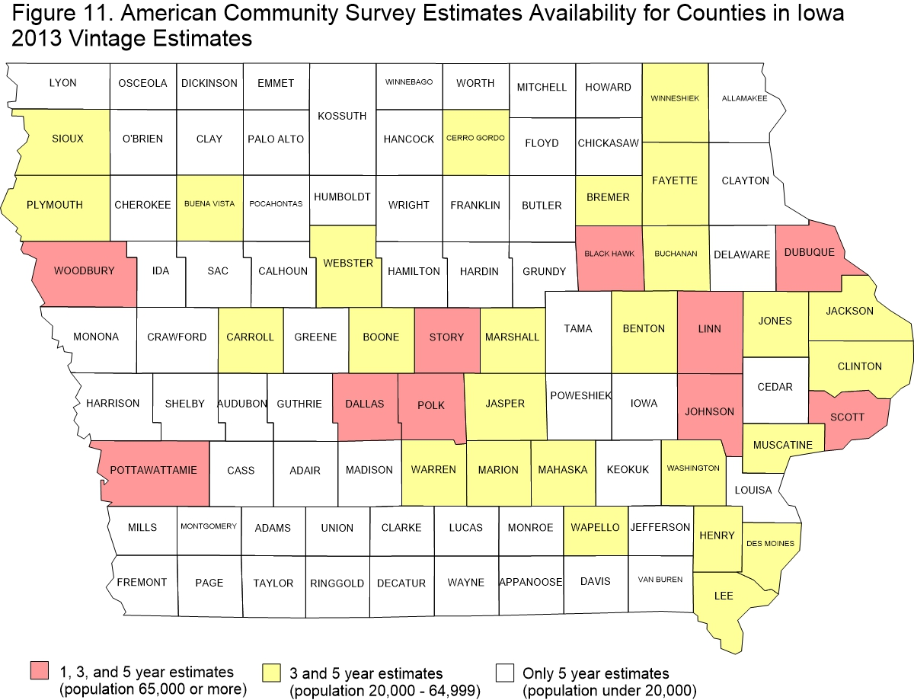

Slide 14
Figure 13. Income Measurement and Data in the ACS
ACS income concept is money or cash received by individuals
ACS questionnaire asks income for each person age 15+
Previous 12 months before doing the ACS survey
Collects from individuals then adds to get household, family, and aggregate totals
“Bottom-up” approach
Notes:
ti

Slide 15
Previous 12 months for each type

Slide 16
Figure 14. Income Types in the ACS Questionnaire
wages, salaries, commissions, bonuses, tips from all jobs; before deductions for taxes, etc.; i.e. pretax income
self-employment net income from business; nonfarm, farm, proprietorships, partnerships
interest, dividends, net rental, royalty, estate or trust income
Social Security or Railroad Retirement
Supplemental Security Income (SSI)
Public assistance or welfare payments from state or local sources
Retirement, survivor, or disability pensions (not Social Security)
Other income; veterans payments, unemployment , child support, alimony
Notes:
ti

Slide 17
Figure 15. What is NOT included in ACS income
ACS Income concept is money or cash received by individuals, however does not include many things
Does NOT include “in-kind” benefits (SNAP/food stamps); housing subsidy support; imputed income or benefits; or benefits paid to organizations on behalf of individuals
Does NOT include inheritances
Does NOT include capital gains from sales home, stocks, etc.
Does NOT include value of assets owned
How the ACS counts income; other programs may differ

Slide 18
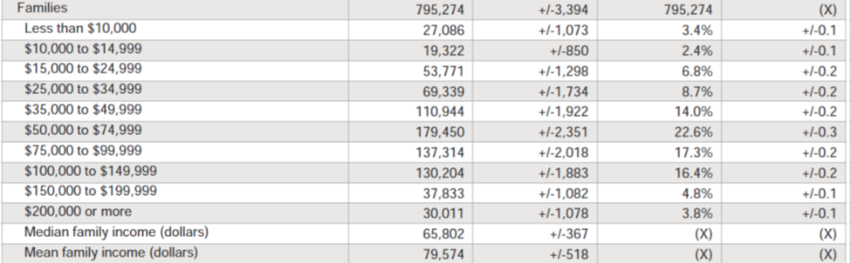
Figure 16. Families Income Distribution, Iowa, 5-year estimates, 2009 - 2013

Slide 19
Figure 17. Families or Family Households and Income
(subset of all households)
Two or more persons in an occupied housing unit who are related to each other
Family income includes that of householder plus all other persons 15 years or over who are related to householder
Incomes are summed and totals for family households are reported as a distribution across income categories
Poverty level determined for whole family together, all same poverty status

Slide 20
Figure 18. Unrelated Individuals
Persons not living with persons to whom they are related
Could be living alone or with roommates
Living in households or small group situations, not institutional quarters
Income and poverty level determined by just own income

Slide 21
Figure 19. Persons for whom Poverty Status is Determined
Poverty status was determined for all people except:
institutionalized people
people in military group quarters
people in college dormitories
unrelated individuals under 15 years old.
These groups were excluded from the numerator and denominator when calculating poverty rates.

Slide 22
Figure 20. Poverty Thresholds
Income level below which the persons are considered to be in poverty
Based on family size, number of children
For 1 and 2 person households also based on age
All members of family given same poverty status
Unrelated individuals have their own poverty status
Number below poverty is sum of persons in families below poverty and unrelated individuals below poverty

Slide 23
Figure 21. Official Poverty Thresholds
Issued by Census Bureau
Adjusted annually based on Consumer Price Index
Historically started with budget meal plan, updated from earlier matrix by CPI
Actually looking back to previous year’s pricing; in 2015 get the poverty thresholds to be used for the 2014 ACS income data
Compare family or individual income to the $$ thresholds
Used for statistical purposes to calculate the official poverty population

Slide 24
Figure 22.

Slide 26
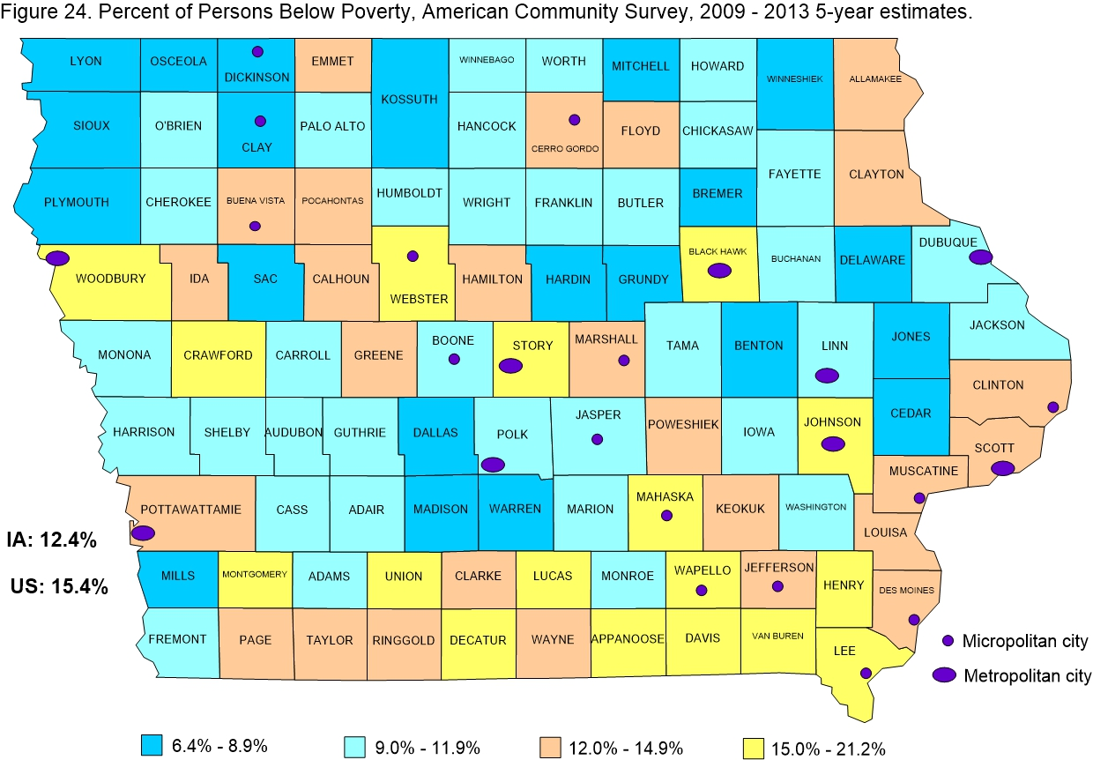

Slide 27
Figure 25. Selected Poverty Data Provided Here
American Community Survey, 5-Year Estimates, 2009 – 2013
Selected items from Tables: S1701, S1702, B17010, B17012, DP02
Iowa and U.S. (pages 26 – 27)
Adams Co, Plymouth Co (pages 28 – 29)
Polk Co, Dallas Co (pages 30 – 31)
Decatur Co, Davis Co (pages 32 – 33)
Black Hawk Co, Bremer Co (pages 34 – 35)
Johnson Co, Wapello Co (pages 36 – 37)

Slide 28
Figure 26. Iowa Poverty Data (page 26)
Age – Children tend to have higher rates than older
Race and Hispanic origin – Blacks and African Americans tend to have higher rates than other groups
Education – People with higher levels of education tend to have lower poverty rates than those with less education
Employment Status – Those employed, especially if full-time and year-round, tend to have lower poverty rates than those unemployed
Sex – In a wide variety of circumstances, females tend to have higher poverty rates than males

Slide 29
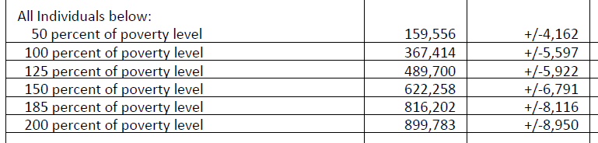
Figure 27. Percent of Poverty Level (2009 – 2013)
Percent of poverty level is amount/proportion of income relative to the family’s or person’s poverty threshold
100% of poverty level means income was below the threshold; thus the basic number below
50% of poverty level means income was below half the threshold
125% means income up to 25% higher than the threshold
150% means income up to 50% higher than the threshold
200% means income up to double the threshold

Slide 30
Figure 28. Poverty Guidelines
The guidelines are a simplification of the poverty thresholds for use for administrative purposes
A primary use is determining financial eligibility for certain federal programs.
Set issued by Health and Human Services is used often
Issued for current year that they are to be used
Based on price changes from previous year
Separate guidelines sets for Alaska and Hawaii

Slide 31
Figure 29. Health and Human Services 2015 Poverty Guidelines
2015 POVERTY GUIDELINES FOR THE 48 CONTIGUOUS STATES AND THE DISTRICT OF COLUMBIA |  | Alaska | Hawaii
Persons in family household | Poverty guideline | Poverty guideline | Poverty guideline
1 | $11,770 | $14,720 | $13,550
2 | 15,930 | 19,920 | 18,330
3 | 20,090 | 25,120 | 23,110
4 | 24,250 | 30,320 | 27,890
5 | 28,410 | 35,520 | 32,670
6 | 32,570 | 40,720 | 37,450
7 | 36,730 | 45,920 | 42,230
8 | 40,890 | 51,120 | 47,010
9+ add for each | $4,160 | $5,200 | $4,780

Slide 32
Figure 30. Income Limits, Housing and Urban Development, Iowa, 2015

Slide 33
Figure 31. Income Limits, Housing and Urban Development, Appanoose County, Iowa 2015

Slide 34
Figure 32. Income Limits, Housing and Urban Development, Dallas County, Iowa, 2015

Slide 35
Figure 33. Program Eligibility Guidelines
Guidelines may be similar to threshold levels, but may differ in important ways
Different agencies can and do use different guidelines
Different agencies count different resources!!!
States may differ on guidelines
Consult the agency’s information!!!

Slide 36
Figure 34. Small Area Income and Poverty Estimates (SAIPE) Program
people and children in poverty
median household income
Model based estimates produced by Census Bureau
Model includes information from ACS survey, IRS tax filings, BEA personal income estimation, Decennial Census 2010, SNAP (food stamp) benefits, Decennial Census 2000

Slide 37
Figure 35. Small Area Income and Poverty Estimates (SAIPE)
Annual poverty estimates
  all ages in poverty
  under age 18 in poverty
  ages 5 to 17 in families in poverty
  under age 5 in poverty (state and U.S. only)
Single year estimates all counties
not pooled years
Margins of error ---- Confidence intervals may be asymmetric

Slide 38
Figure 36. Small Area Income and Poverty Estimates (SAIPE) State of Iowa
SAIPE all ages 2013 377,037 (+/- 9,721)
ACS all ages 2013 367,414 (+/- 5,597) 5 year estimates
SAIPE all ages 2013 12.6% (+/- 0.3)
ACS all ages 2013 12.4% (+/- 0.2) 5 year estimates
SAIPE under age 18 2013 114,304 (+/- 5,564)
ACS under age 18 2013 114,742 (+/- 3,169) 5 year estimates
SAIPE under age 18 2013 16.0% (+/- 0.8)
ACS under age 18 2013 16.1% (+/- 0.4) 5 year estimates

Slide 39
Figure 37. Current Population Survey’s Annual Social and Economic Supplement (CPS ASEC)
Nationwide, monthly survey; focus on labor force
Month of March supplemental questions demographic, social, economic information
Poverty and income with broad range of detail
Predominantly national data
Annual report; heavily publicized and reported
Income and Poverty in the United States: 2013
Official U.S. poverty rate 14.5% 2013
State poverty rates included Iowa 10.8% 2013
State table (POV46) only on the Census Bureau’s web site
Notes:
V

Slide 40
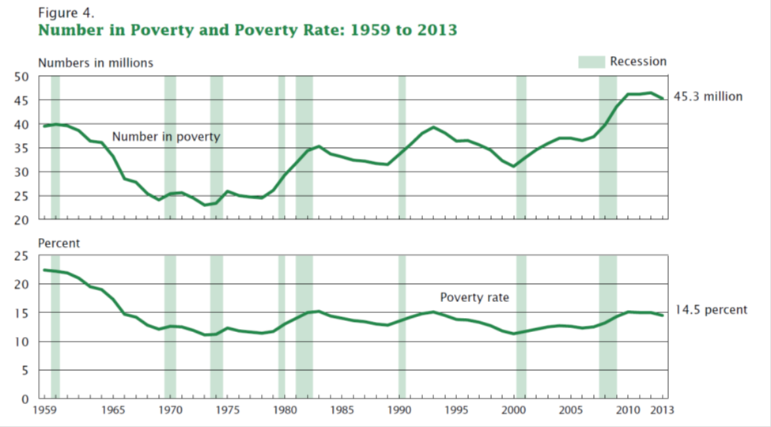
Figure 38.

Slide 41
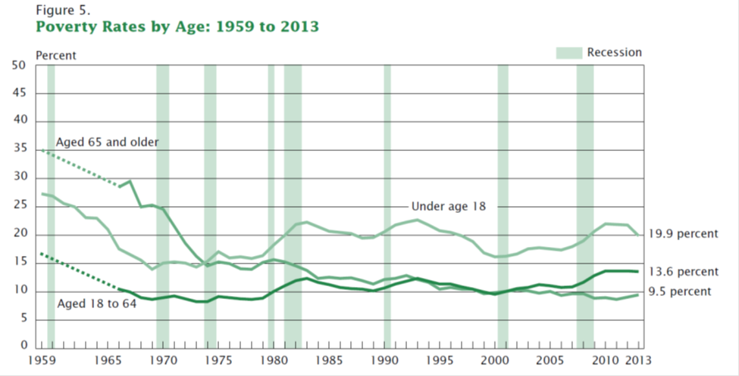
Figure 39.

Slide 42
Figure 40. School Meals Programs U.S. Department of Agriculture (USDA)
National School Lunch Program, School Breakfast Program, Others
Participation in programs is indicator of poverty
Administered by Iowa Department of Education
Data on student participation by school district available on web site under Data/Reporting, Education Statistics
Iowa 2014-2015 year public schools
K-12 enrollment free reduced total %
477,422 162,298 33,519 195,817 41.02
districts range from: 6.45% to 99.7%

Slide 43
Figure 41. Districts with Lowest School Meal Participation, 2014-2015

Slide 44
Figure 42. Districts with Highest School Meal Participation, 2014-2015

Slide 45
Figure 43.

Slide 46
Figure 44. Supplemental Nutrition Assistance Program (SNAP) (Food stamps) U.S. Department of Agriculture
Participation in the program is an indicator of poverty
Benefit varies by household size
Can only purchase food items with SNAP assistance
Non food items, alcoholic beverages, tobacco, etc. ineligible
Administered in Iowa by Department of Health and Human Services; monthly reports with state and county data
Iowa April, 2015 390,277 recipients 184,519 households
caution – eligibility requirements have changed across time

Slide 47
Figure 45. SNAP recipients, Iowa, FY 2014 – FY 2015

Slide 48
Figure 46. SNAP Recipients and Households, Iowa, April , 2005 - 2015

Slide 49
Poverty
Food Insecurity
Economic Well-Being
Access and distance to food stores
Nutrition and health indicators
Food and family assistance program trends
Economic data
Demographic data
www.icip.iastate.edu/special-reports/poverty

Slide 50
Figure 47. Portal Project
indicators.extension.iastate.edu
Tutorial
Login
What is there
Choose geography
Data fun!!
Choose Geography

Slide 51
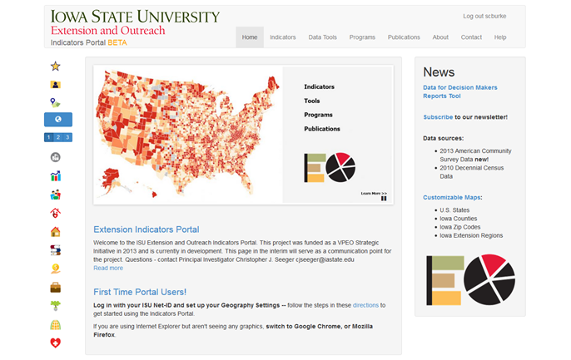
Figure 48. Indicators Portal Home Page

Slide 52
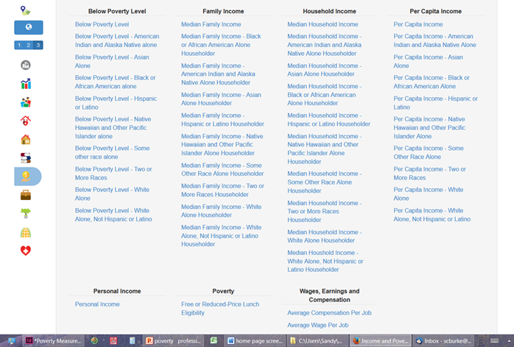
Figure 49. Poverty and Income Data List

Slide 53
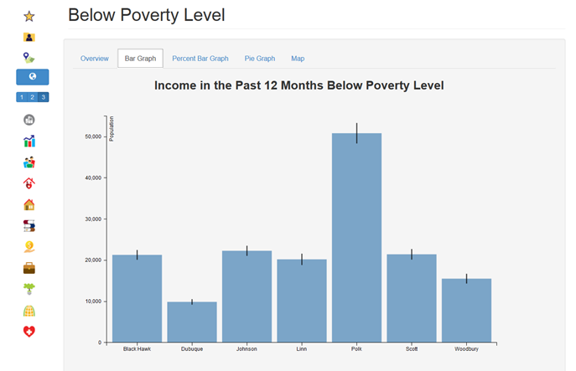
Figure 50. Number of Person Below Poverty, Selected Geographies

Slide 54
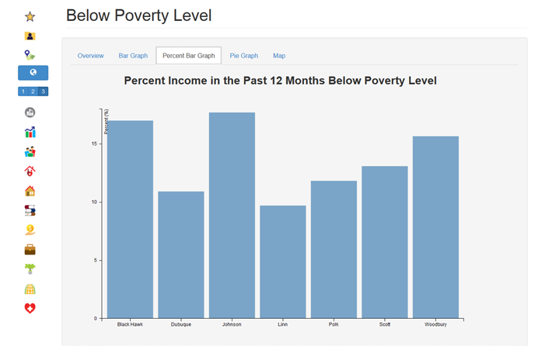
Figure 51. Percent of Person Below Poverty, Selected Geographies

Slide 55
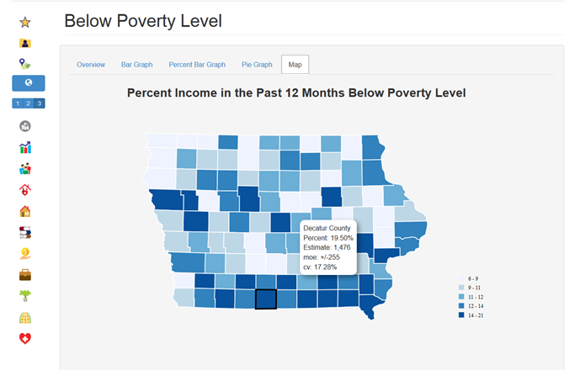
Figure 52. Percent of Person Below Poverty, Iowa Counties Map

Slide 56
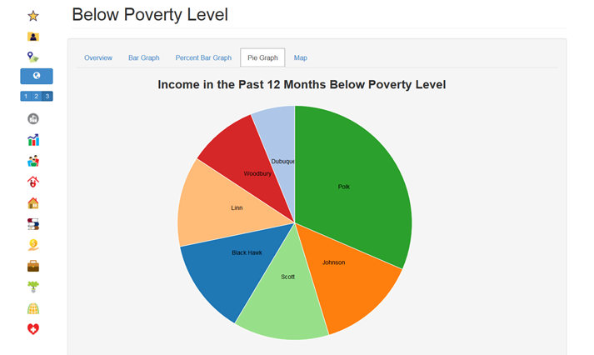
Figure 53. Pie Chart of Number of Person Below Poverty, Selected Geographies

Slide 57
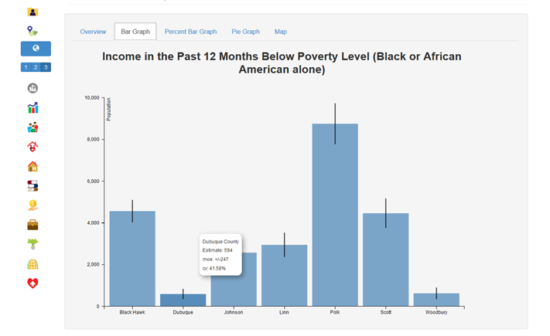
Figure 54. Number of Blacks or African Americans Below Poverty, Selected Geographies

Slide 58
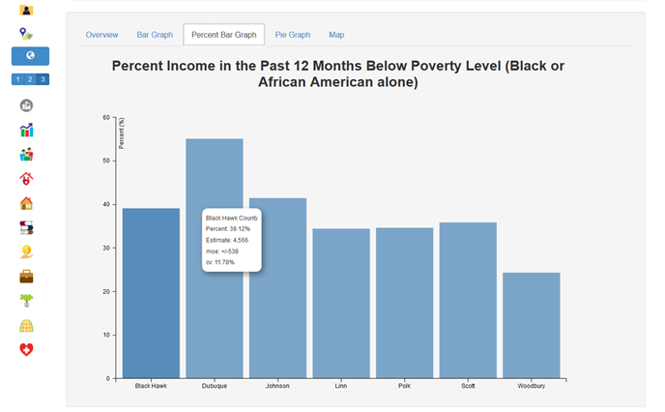
Figure 55. Percent of Blacks or African Americans Below Poverty, Selected Geographies

Slide 59
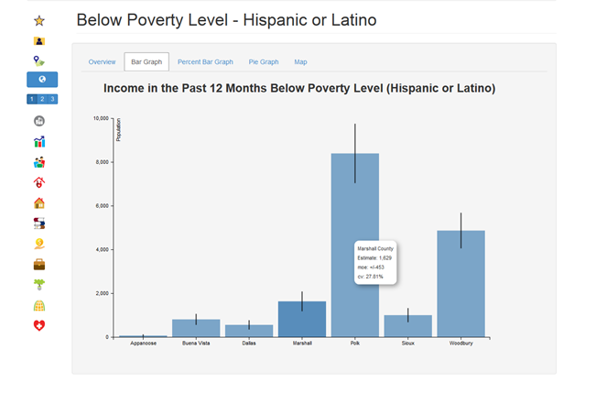
Figure 56. Number of Hispanics Below Poverty, Selected Geographies

Slide 60
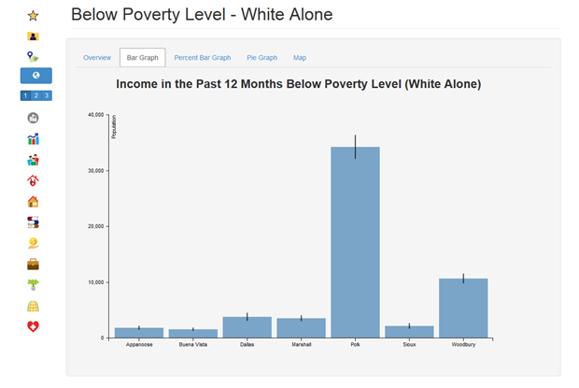
Figure 57. Number of Whites Below Poverty, Selected Geographies

Slide 61
Figure 58. Things to Look At and Some Questions to Answer (pages 26 – 27)
Which has highest poverty rate? Iowa or US?
Margin of error for Iowa poverty rate?
Is poverty rate higher for those age 65+ or those under age 18?
How does Iowa Black/African American poverty rate compare to rate for White?
Margin of error for Iowa Native Hawaiian poverty rate?
Is Iowa poverty rate for Hispanics higher or lower than for Blacks?

Slide 62
Figure 59. Answer More Questions (page 26)
Does education level tend to decrease poverty?
Does unemployment tend to decrease poverty?
Poverty rate married couple families Iowa?
With related children?
Poverty rate female householders, no husband present Iowa?
With related children?

Slide 63
Figure 60. More Things to Look At and Questions (pages 28 - 33)
Adams County smallest county
MOEs age groups poverty rate MOEs
MOEs race groups poverty rate MOEs
Plymouth County lower poverty rates subgroups MOEs
Polk County largest county
diversity many subgroup MOEs probably ok
Dallas County lowest poverty rate (along with Plymouth)
poverty rate married couple families
Decatur County high poverty rates
Davis County highest poverty rate

Slide 64
Figure 61. More Questions (pages 34 – 37)
Black Hawk County high poverty rates compare with Polk
Bremer County contrast to neighbor Black Hawk
Johnson County higher poverty rate students in apartments
compare with Black Hawk
compare family poverty rates
poverty rate married couple families
Wapello County high poverty rates

Slide 65

Thank you
Portal Project Web Page: indicators.extension.iastate.edu
Sandra Burke
scburke@iastate.edu
515-294-9307
Cynthia Fletcher
cynthia@iastate.edu
Liesl Eathington
leathing@iastate.edu
www.icip.iastate.edu
Marybeth Foster
mbfoster@iastate.edu
Glennda Bivens
glennda@iastate.edu
Bailey Hanson
bahanson@iastate.edu

